Slide 1

DEPARTMENT OF COMPUTER SCIENCE
Project Presentation (KCS 753)
BLIND IMAGE RESTORATION AND DATA AUGMENTATION
Project Id- PCS-09
Project Guide-Dr Harsh Khatter
Team Members-
Avishi Tayal (2000290120051-A)
Nandini Tyagi (2000290120099-B)
Piyush Gupta (2000290120105-B)

Slide 2
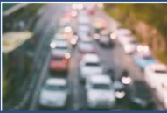
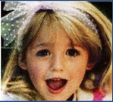
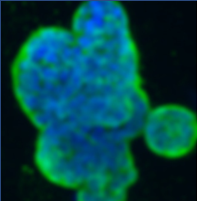
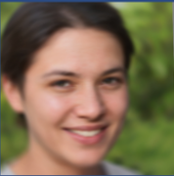
Problem Statement
Achieving high-quality image restoration remains a formidable challenge in computer vision.
Problems such as motion blur, noise, and image quality degradation need to be effectively addressed.
Augmenting datasets for machine learning model training is essential but often limited by data availability.
This project aims to develop a blind image restoration model and generate augmented datasets to enhance model training.
The objective is to improve image restoration and data augmentation techniques, thereby advancing computer vision applications in areas such as surveillance, medical imaging, and more.

Slide 3
Objectives:
Blind image restoration aims to estimate clean images from degraded, noisy, or blurry versions without any knowledge of the degradation process.
Data augmentation using GAN model generates synthetic data samples by training on existing samples to increase the size and diversity of the dataset.
The combination of these two techniques can enhance the performance of computer vision models.

Slide 4
Proposed Solution
GPEN model will first enhance the resolution of distorted and noisy images.
GAN models facilitate the creation of images by employing a generator and discriminator.
The generator produces images based on random vectors from a Gaussian distribution. The discriminator evaluates these generated images and compares them to real images from the training data.
The GAN model will generate the artificial data from the given input (different poses).

Slide 5
Technology Used:
Hardware :
High-Performance GPUs (Graphics Processing Units)
Multicore CPUs (Central Processing Units)
Sufficient RAM (Random Access Memory)
High-Resolution Displays
Data Storage Solutions
Network Infrastructure
Software :
Generative Adversarial Networks (GANs)
GFP-GAN (GFP Generative Adversarial Network)
StyleGAN
Pixel Restoration
Diverse Augmented Datasets
Multidisciplinary Applications
Collaborative Approach

Slide 6
Literature Survey
Title-“Generative adversarial networks”
Author- I. Goodfellow et al.
Journal-ACM
Year-2020,
Ian J. Goodfellow et al.[1] have implemented a Generative Adversarial Network. The author employed this model with the help of two functions Generator and Discriminator. Here both functions have different meanings. According to the research Generator is responsible for capturing the data whereas Discriminator is responsible for estimating the probability that the feature comes from training data or captured image. Author has trained model on various famous datasets that are MNIST, CIFAR-10, TFD etc. Author had not used any Markov chains or unrolled approximate inference files during the training of model.

Slide 7
Title- “GAN Prior Embedded Network for Blind Face Restoration in the Wild”
Author- T. Yang, P. Ren, X. Xie, and L. Zhang
Journal: IEEE
Year- 2021
Tao Yang et al.[2] have worked upon “Blind Face Restoration” by using GAN prior embedded network (GPEN). The author has researched that GAN models are used to improve the quality of degraded image but they make the image over smooth which is not a better result. That’s why concept of GPEN came in which GAN model is mapped with U shaped Deep neural network to achieve better results in terms of quality and quantity as well. In the research, U-shaped Deep neural network is trained by using U-net model to make the results better.

Slide 8
Title- “Blind Face Restoration via Integrating Face Shape and Generative Priors”
Author- F. Zhu et al
Journal- CVPR
Year- 2022
Feida Zhu et al.[3] aims to reconstruct high-quality images from low-quality images. It was found that the real world is suffering from the degradation of low-quality face images during data acquisition and Internet transmission. So, the Author has employed SGPN Shape and Generated a prior integrated network to solve this problem. The approach of the whole methodology starts with the shape restoration module to balance the face geometry. After that by following D3DFR author regressed 3DMM coefficients with Resnet50. Then, shape S and 12 colored texture C formed which is used to make a 2D image plane to obtain 3D image.

Slide 9
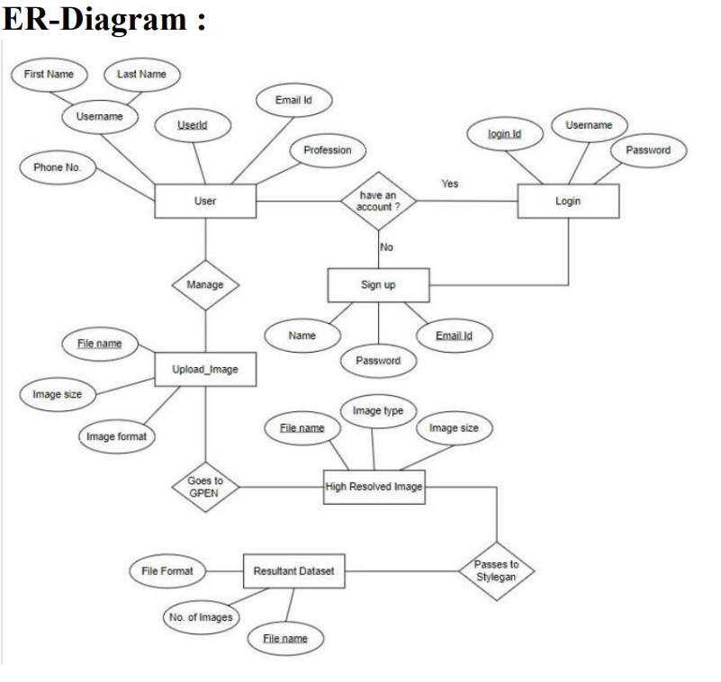

Slide 10
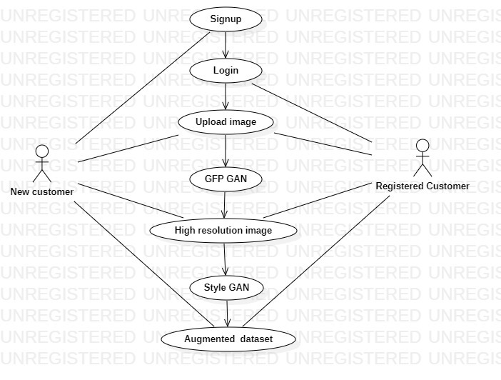
Use Case Diagram

Slide 11
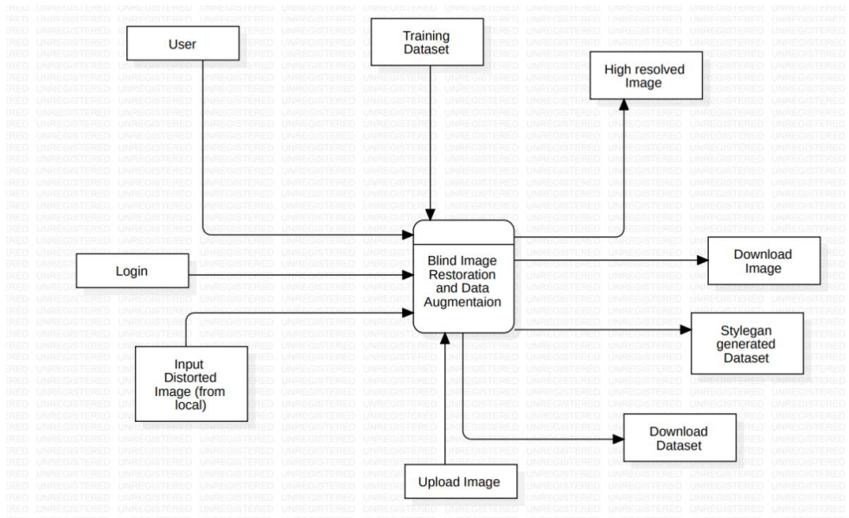
DFD Level 0

Slide 12
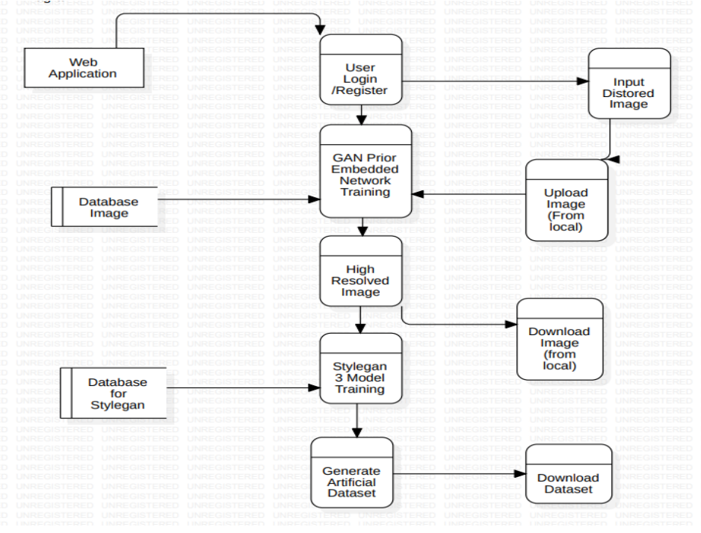
DFD Level 1

Slide 13
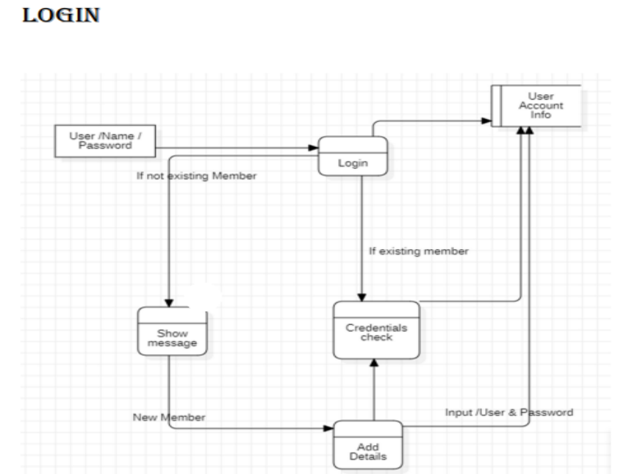
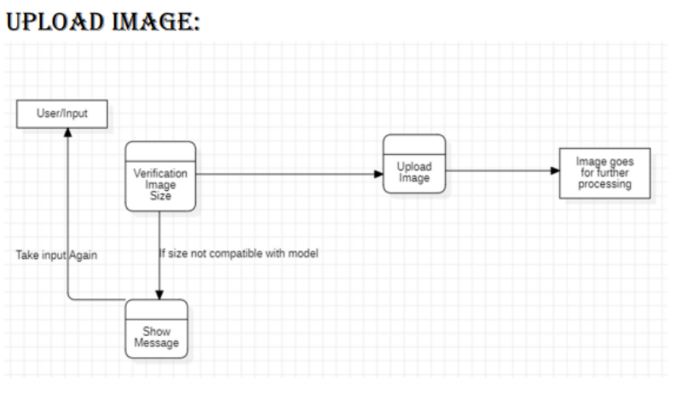
DFD Level 2

Slide 14
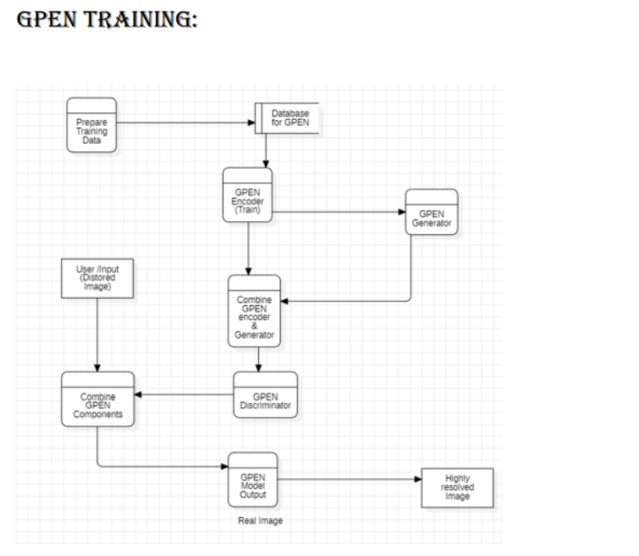
DFD Level 2

Slide 15
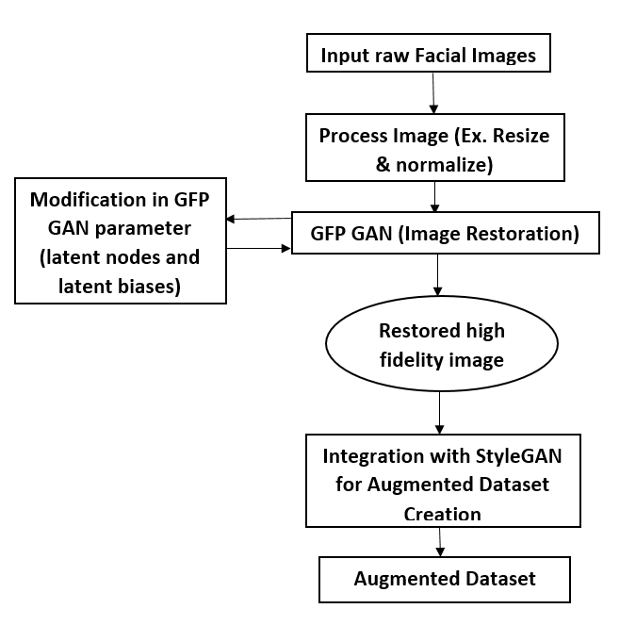
Workflow Diagram

Slide 16
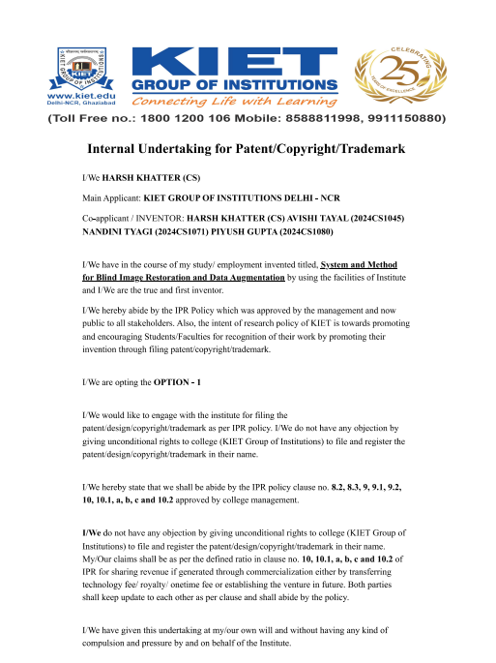
Patent Status:

Slide 17
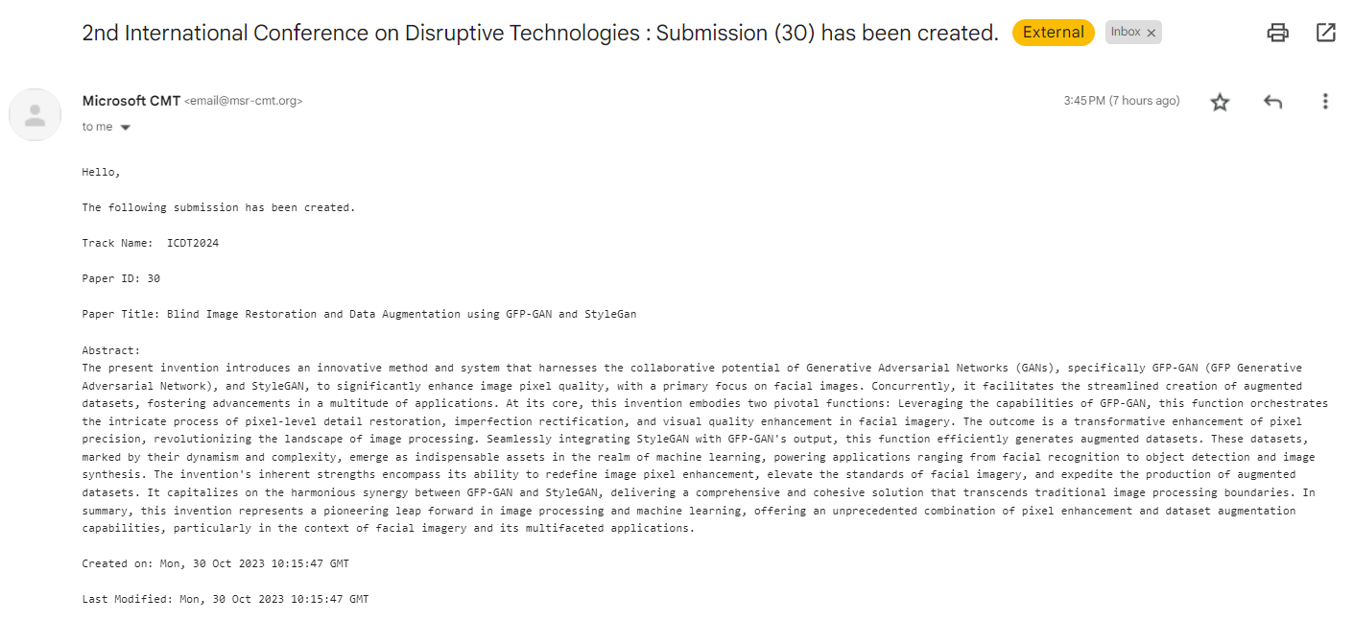
Research Paper Status

Slide 18
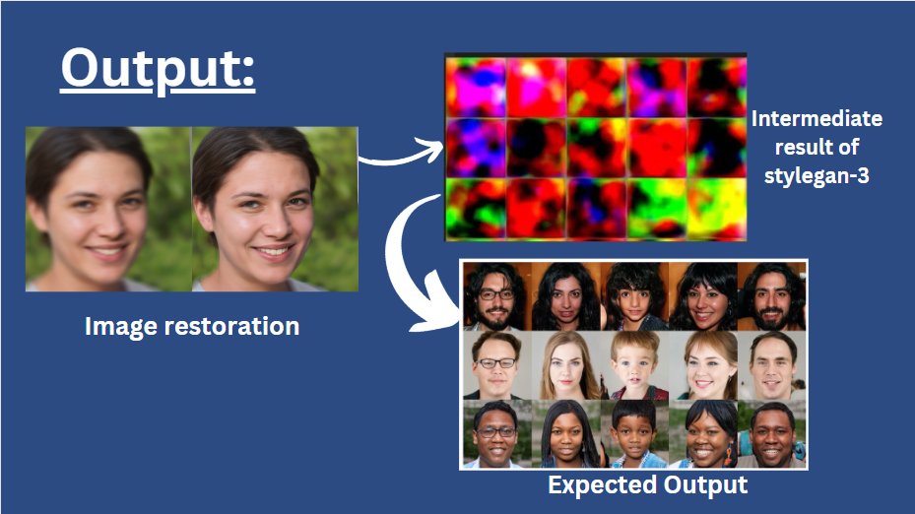
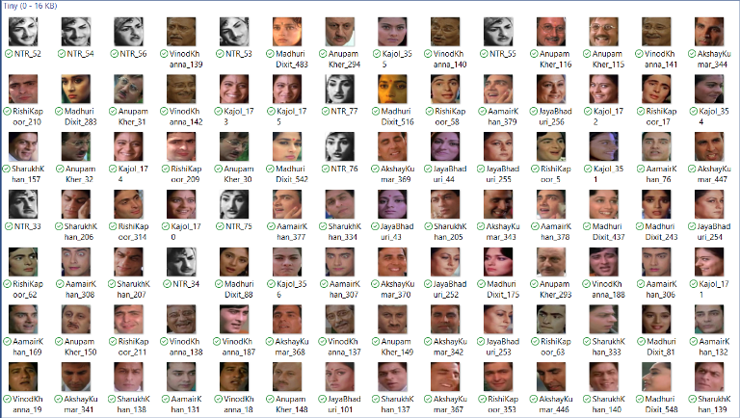
Project Status
Dataset:

Slide 19
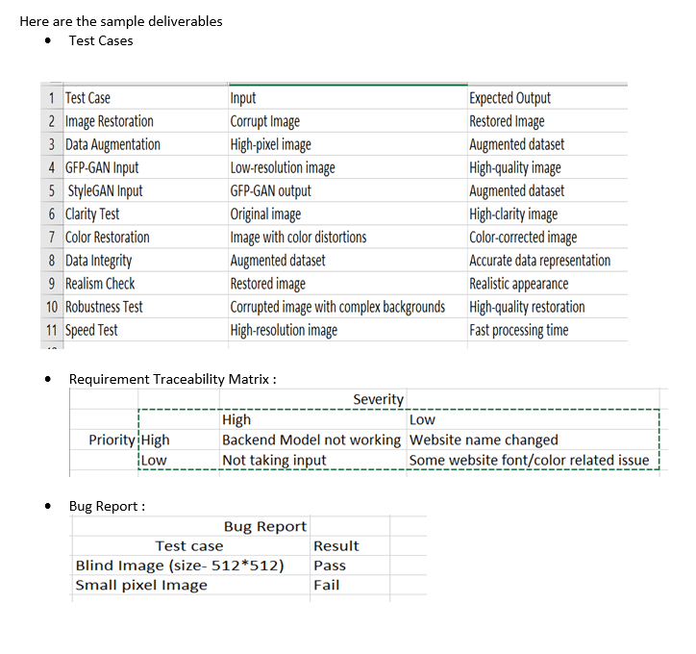
Testing Report
*Manual testing is performed

Slide 20
References
[1] I. Goodfellow et al., “Generative adversarial networks,” Commun. ACM, vol. 63, no. 11, pp. 139–144, 2020, doi: 10.1145/3422622.
[2] T. Yang, P. Ren, X. Xie, and L. Zhang, “GaN Prior Embedded Network for Blind Face Restoration in the Wild,” Proc. IEEE Comput. Soc. Conf. Comput. Vis. Pattern Recognit., pp. 672–681, 2021, doi: 10.1109/CVPR46437.2021.00073.
[3] F. Zhu et al., “Blind Face Restoration via Integrating Face Shape and Generative Priors,” pp. 7652–7661, 2022, doi: 10.1109/cvpr52688.2022.00751.
[4] Y. Zhao et al., “Rethinking Deep Face Restoration,” pp. 7642–7651, 2022, doi: 10.1109/cvpr52688.2022.00750.
[5] T. Karras, S. Laine, and T. Aila, “A Style-Based Generator Architecture for Generative Adversarial Networks,” IEEE Trans. Pattern Anal. Mach. Intell., vol. 43, no. 12, pp. 4217–4228, 2021, doi: 10.1109/TPAMI.2020.2970919.

